Slide 1
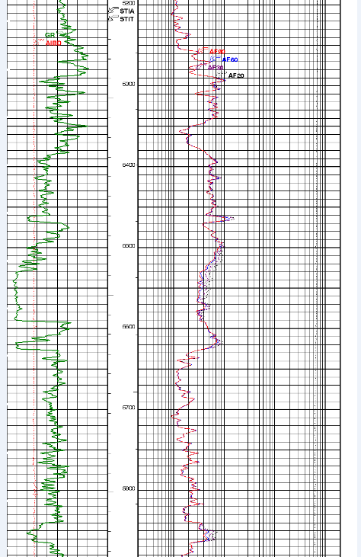
5269 ft
Top Inyan Kara
356
5625 ft
Bottom Inyan Kara

